Slide 1
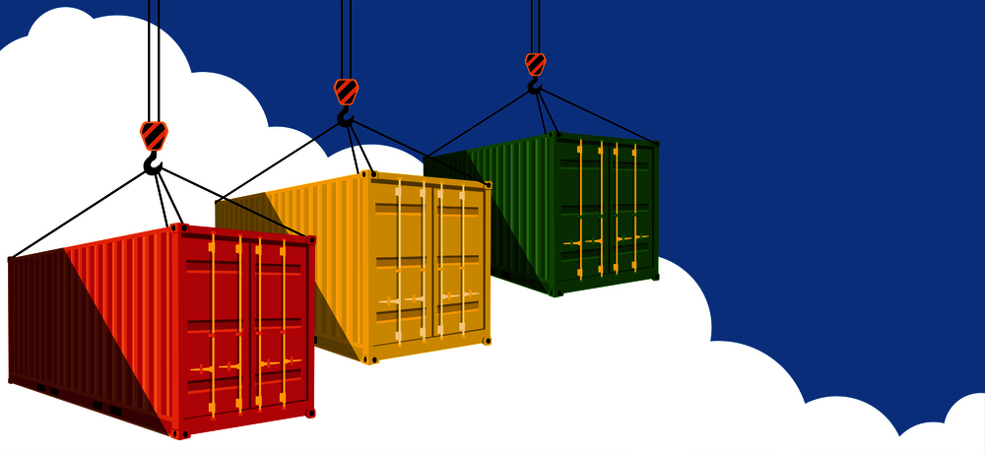
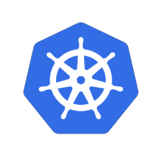
Containers & Kubernetes

Slide 2
Session Overview
Need of containers?
What are containers?
Working of containers
Images
Docker
Kubernetes overview
Master nodes
Worker nodes
Objects of Kubernetes
Q &A

Slide 3
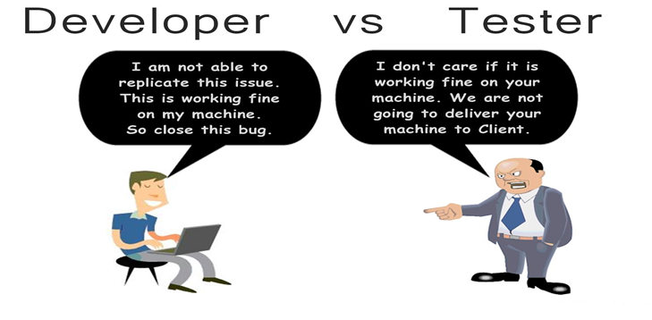

Slide 4
Need of Containers
Bad Old days
For every new application need to buy a new servers
More expensive and time consuming
Requires more time to deployments
Virtualization solved few problems
For every new application need new VM instance
Less expensive as compare to physical servers
Requires less time for deployments
Wastage of server resources
Containers
All about isolation (will get back to it shortly)
More efficient than VM and Physical servers
Requires very small time for deployment

Slide 6
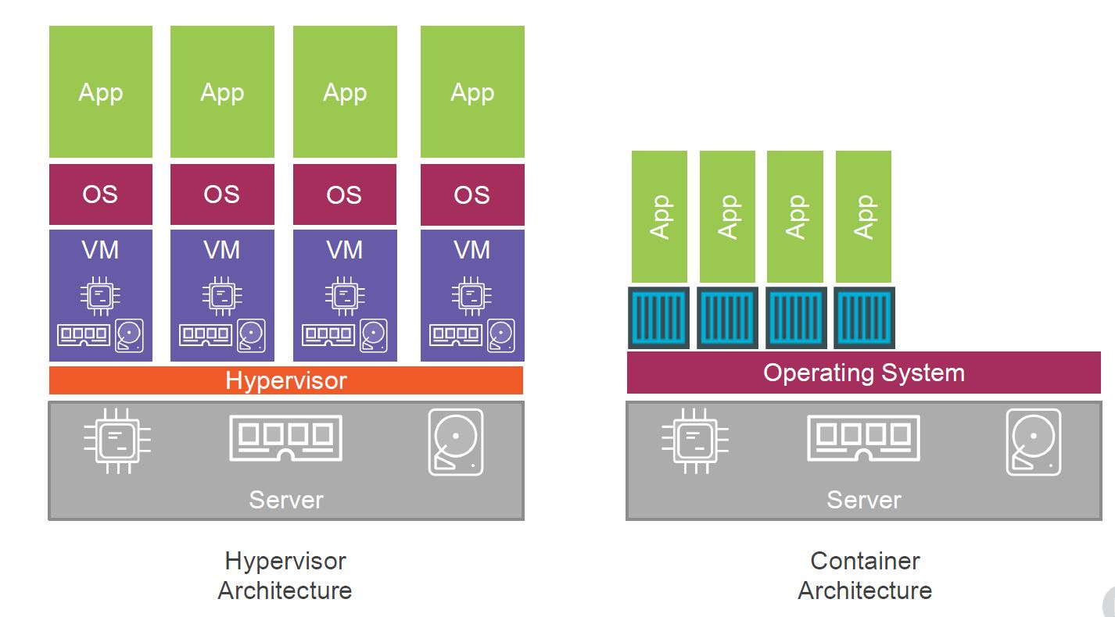
Comparision of Virtualization and Containers

Slide 7
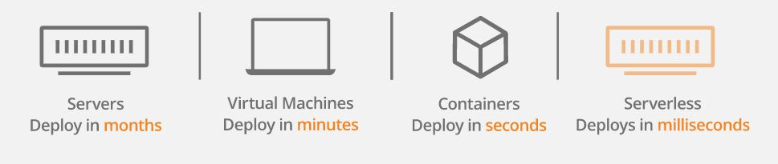
Benefits of using containers

Slide 8
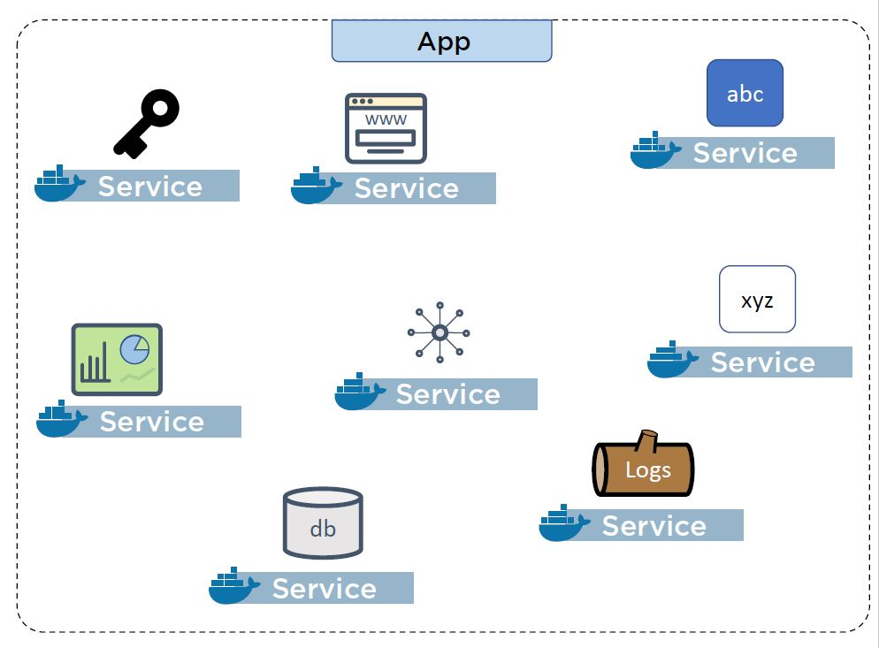
Easy to implement microservice architecture

Slide 9
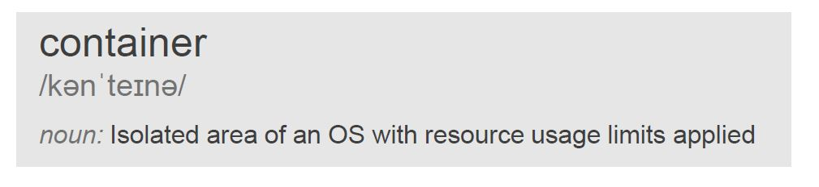
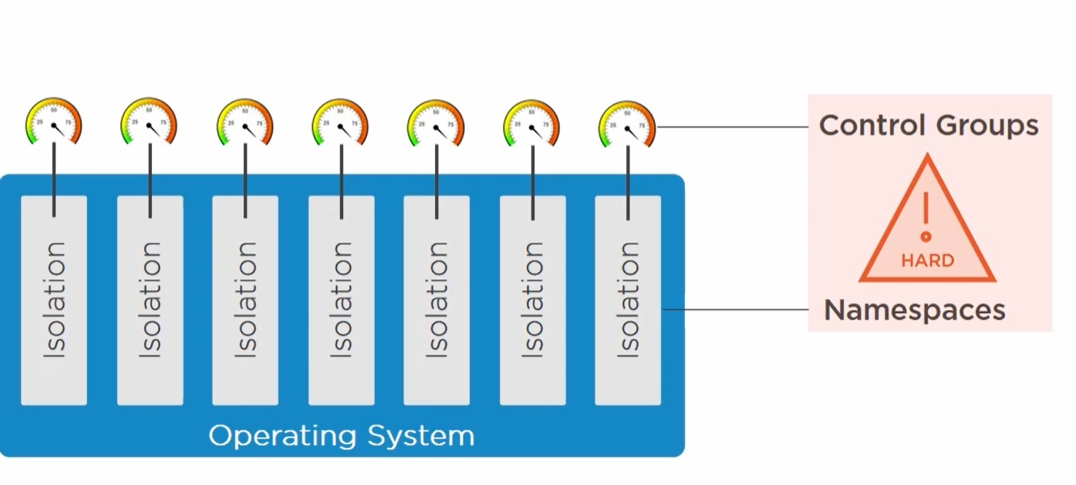
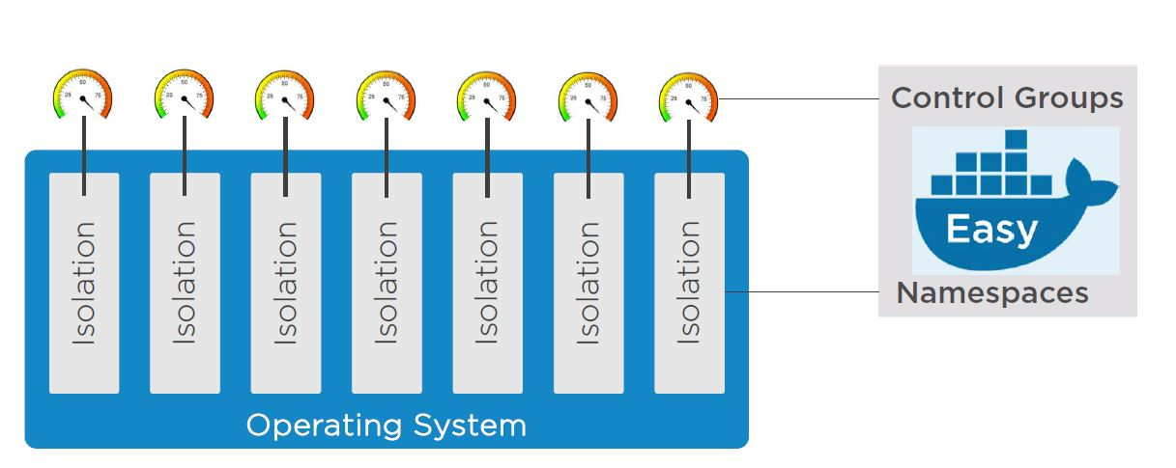

2) What are containers?
Notes:
Types of Namespaces:
PID Namespace: Isolates process IDs, so processes in one container cannot see or interact with processes in another.
Mount Namespace: Isolates the file system view, so containers can have their own directories and cannot access the host or other containers' file systems unless explicitly shared.
Network Namespace: Provides a separate network stack (e.g., IP addresses, routing tables, ports) for each container.
IPC Namespace: Isolates inter-process communication (e.g., message queues, semaphores, shared memory).
UTS Namespace: Isolates the hostname and domain name, so containers can have their own names.
User Namespace: Allows mapping of user IDs (UIDs) and group IDs (GIDs) between the host and the container, enhancing security.
-> Docker uses namespaces to give each container its own process tree (via PID namespace) and file system view (via mount namespace).
Capabilities of cgroups:
CPU Limiting: Restrict the percentage of CPU a container can use.
Memory Limiting: Define memory limits to prevent a container from using excessive memory.
I/O Control: Limit disk I/O bandwidth (e.g., how fast a container can read/write to disks).
Network Bandwidth: Control network usage per container.
Device Access: Restrict access to specific devices (e.g., USB devices).
-> Docker sets CPU and memory limits for containers via cgroups to avoid one container impacting others or the host system.
-> Cgroups ensure that each container gets only its allocated share of CPU, memory, and other resources, preventing a "noisy neighbor" problem.

Slide 10
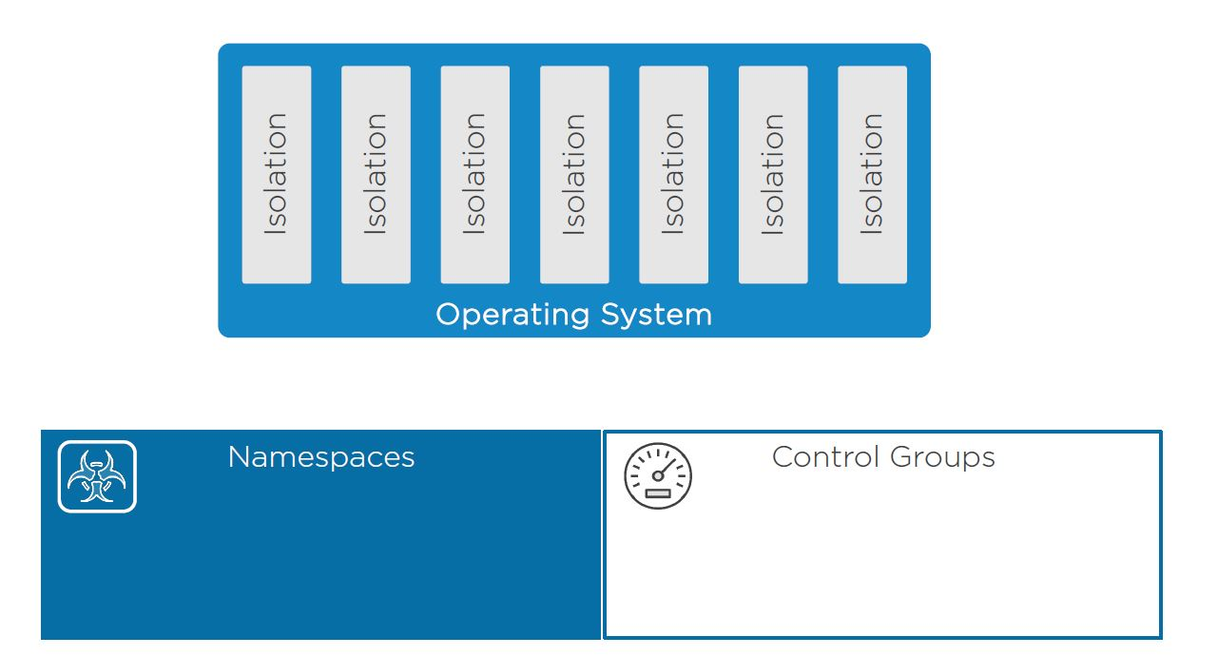
3) How containers works internally
Containers works on following OS kernel primitives of the host machine
Namespaces
Control Groups

Slide 11
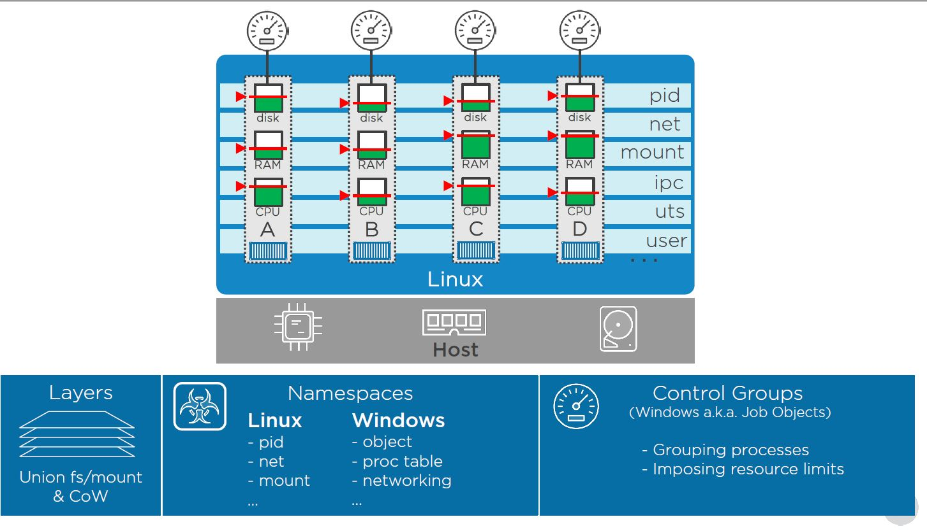
Control Groups

Slide 12
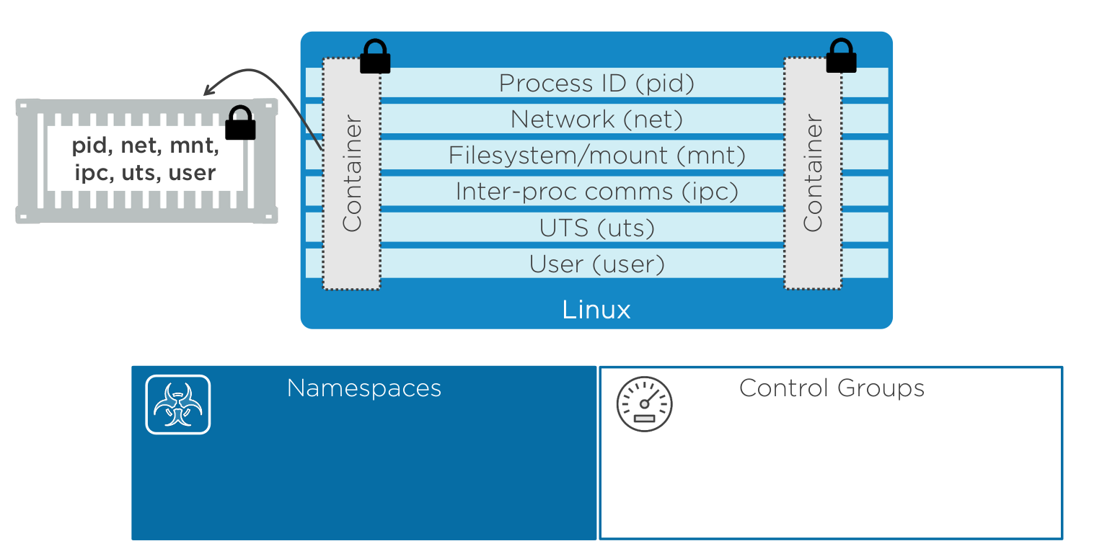
Internals Of Container
Notes:
UTS (UNIX Timesharing System) namespaces are one of the Linux namespaces that help in isolating certain aspects of a container's environment. Specifically, UTS namespaces are used to isolate the hostname and domain name within containers. This means each container can have its own hostname and domain name, independent of the host system or other containers.

Slide 13
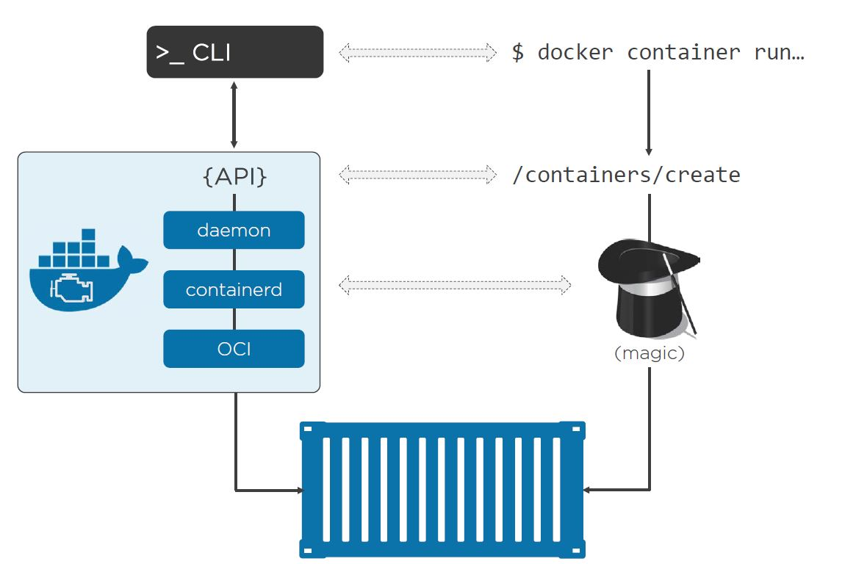
Docker

Slide 14
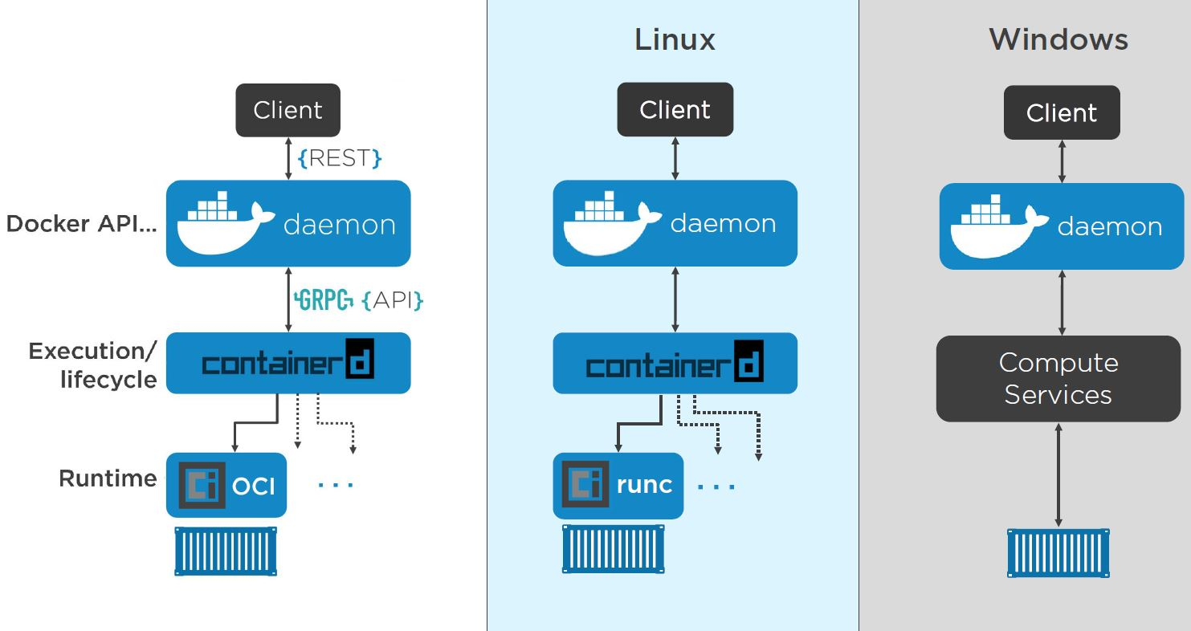
OCI(Open Container initiative)
Notes:
Docker CLI:
Provides an interface for developers to interact with Docker (e.g., docker run, docker build).
Docker API/Daemon:
The daemon (dockerd) is responsible for coordinating container operations. It talks to containerd for low-level execution.
containerd:
A lightweight, high-performance runtime that is responsible for container lifecycle management, such as:
Pulling images
Starting/stopping containers
Managing low-level storage and networking
containerd itself relies on runc.
runc:
A tiny runtime that actually executes the container's process by leveraging Linux features like namespaces and cgroups.
It's the part of the system closest to the Linux kernel.
Linux Stack:
Docker CLI → Docker Daemon → containerd → runc → Linux kernel
Windows Stack:
Docker CLI → Docker Daemon → containerd → HCSShim → Windows kernel (Host Compute Service)
For Linux containers on Windows (via LCOW):
Docker CLI → Docker Daemon → containerd → LCOW utility VM → runc → Linux kernel (inside the VM)

Slide 15
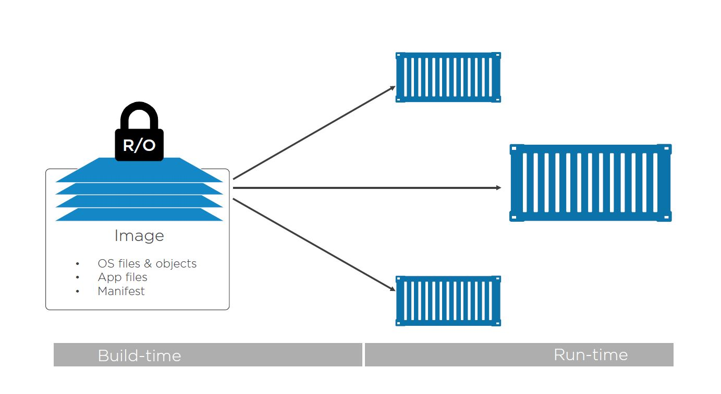
Conitainer Images
In the container, an image is effectively a stopped container. If you’re a developer, you can think of an image as a class.

Slide 16
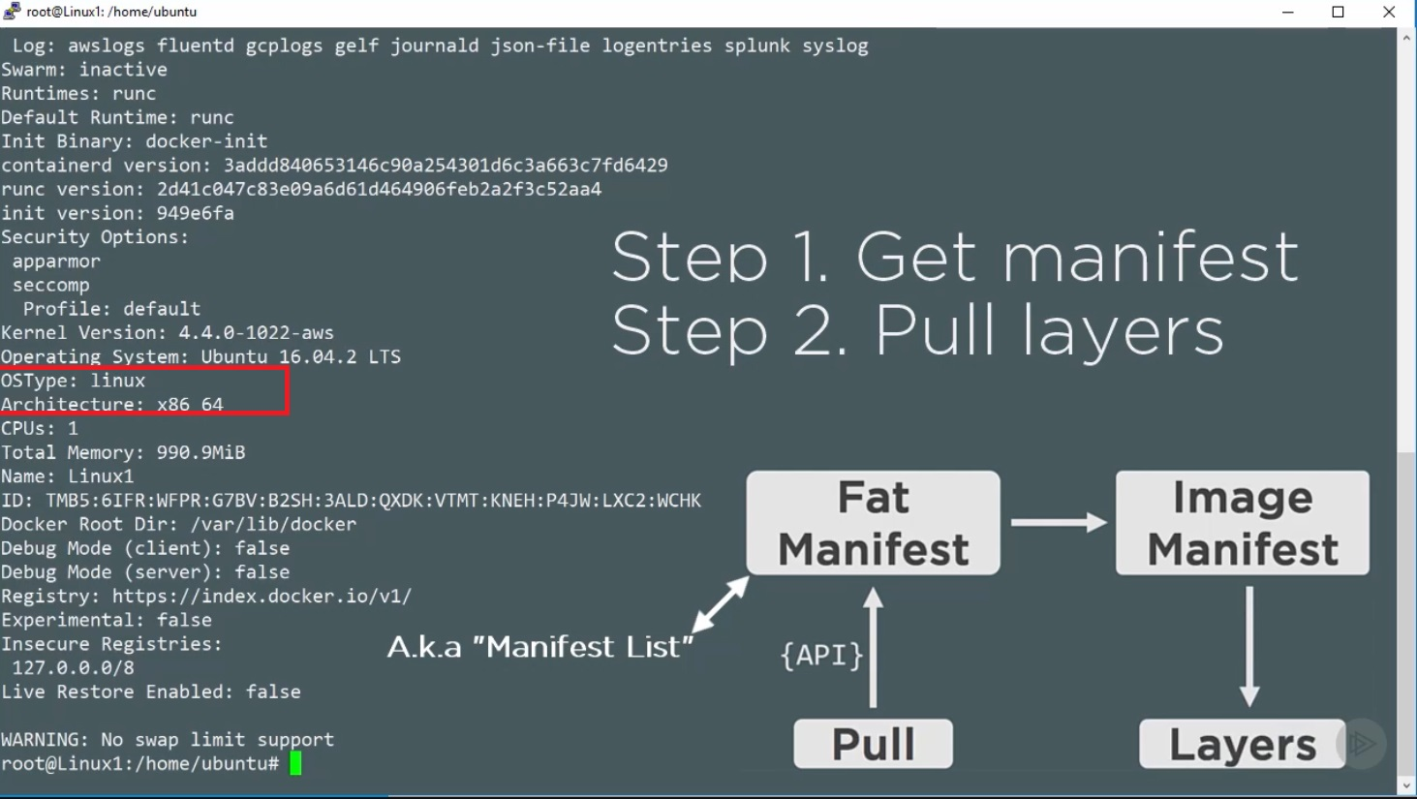
Pulling Images

Slide 17
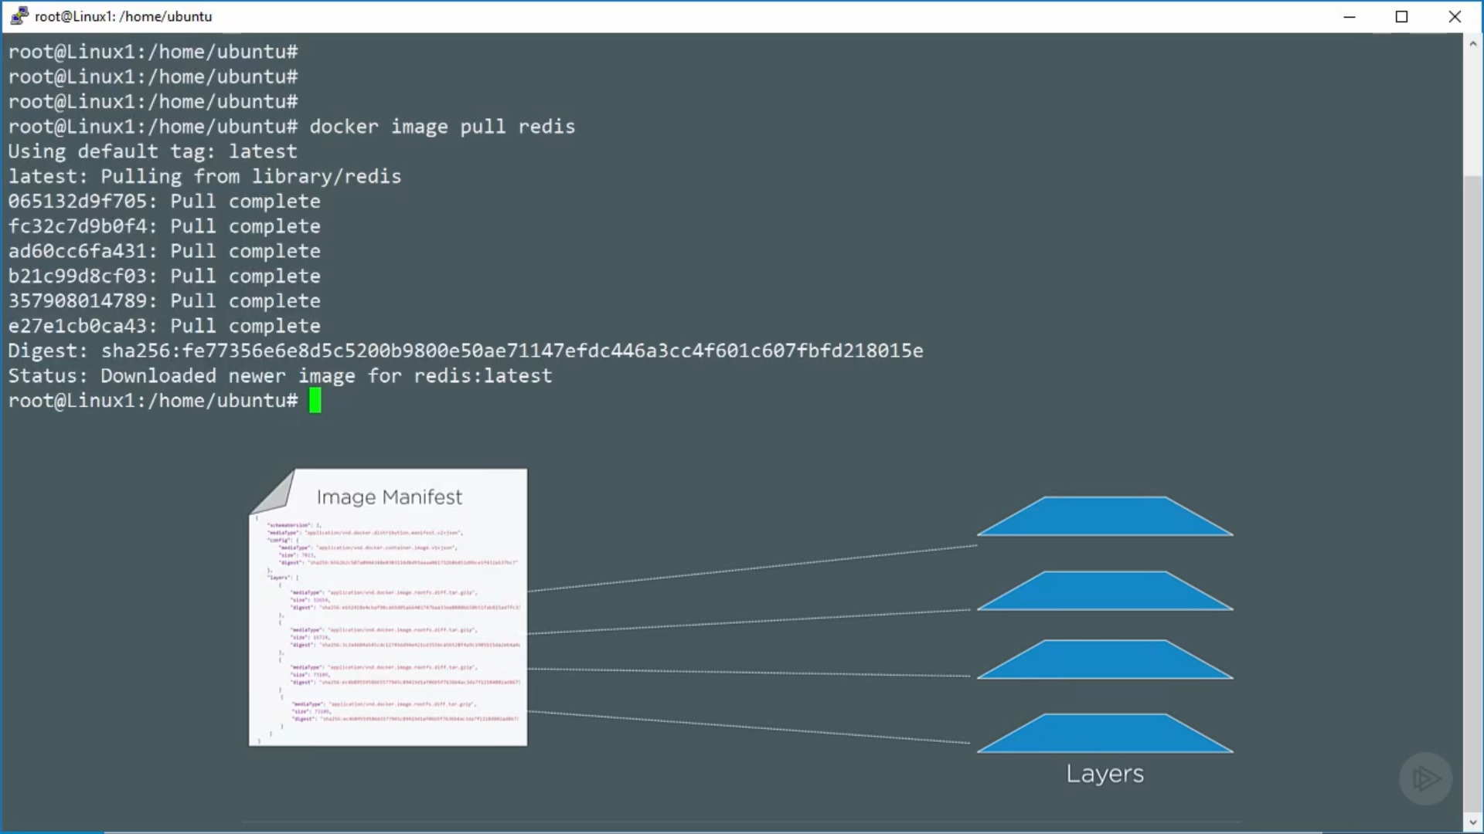

Slide 18
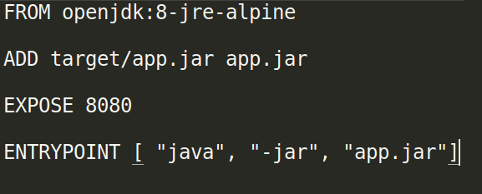
How to build custom images
Docker file

Slide 19
Maximize utilization of cache
# Before Optimization
FROM python:3.9-slim
# Install dependencies (this layer will always be invalidated if source code changes)
RUN pip install -r requirements.txt
# Copy application files (this will cause invalidation of all previous layers if code changes)
COPY . /app
# Set working directory
WORKDIR /app
# Run application
CMD ["python", "app.py"]

Slide 20
Maximize utilization of cache
# After Optimization
FROM python:3.9-slim
# Copy only the requirements file to leverage cache (this won't invalidate the dependencies layer)
COPY requirements.txt /app/requirements.txt
# Install dependencies (this layer will always be invalidated if source code changes)
RUN pip install -r requirements.txt
# Copy application files (this will cause invalidation of all previous layers if code changes)
COPY . /app
# Set working directory
WORKDIR /app
# Run application
CMD ["python", "app.py"]

Slide 21
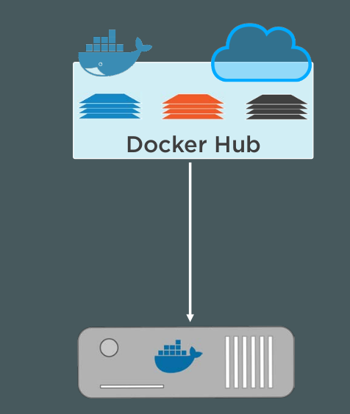
Docker registries

Slide 22
Some Dokcer Commands
docker run -d -p 8080:80 nginx:latest
docker run -d -p 8080:80 -v hostFolderPath:containerPath:ro --name server nginx
docker exec -it server(name of running container) bash
Docker ps
docker build -t website:latest .

Slide 23
Kubernets Overview
Kubernetes (K8s) is an open-source container orchestration platform that automates deployment, scaling, and management of containerized applications
Kubernetes supports container runtimes such as containerd, CRI-O, and any other implementation of the Kubernetes CRI (Container Runtime Interface)
Orchestration tool
Easy to use

Slide 24
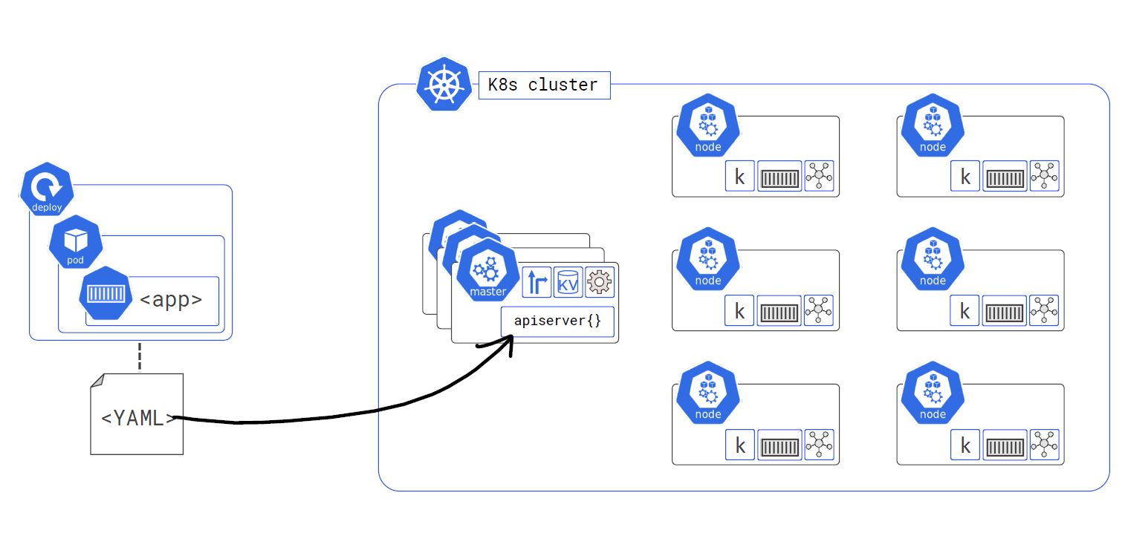
Kubernetes Architecture

Slide 25
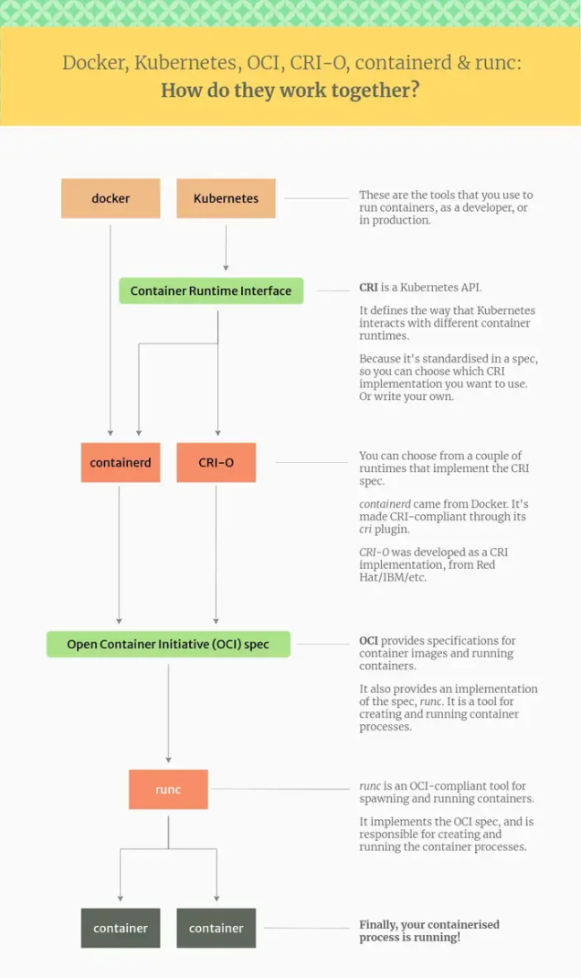

Slide 26
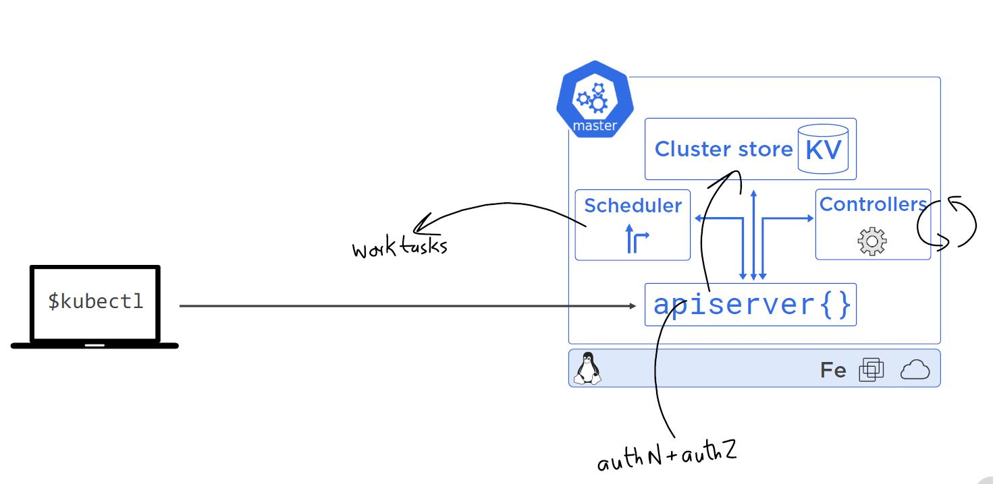
Master Nodes

Slide 27
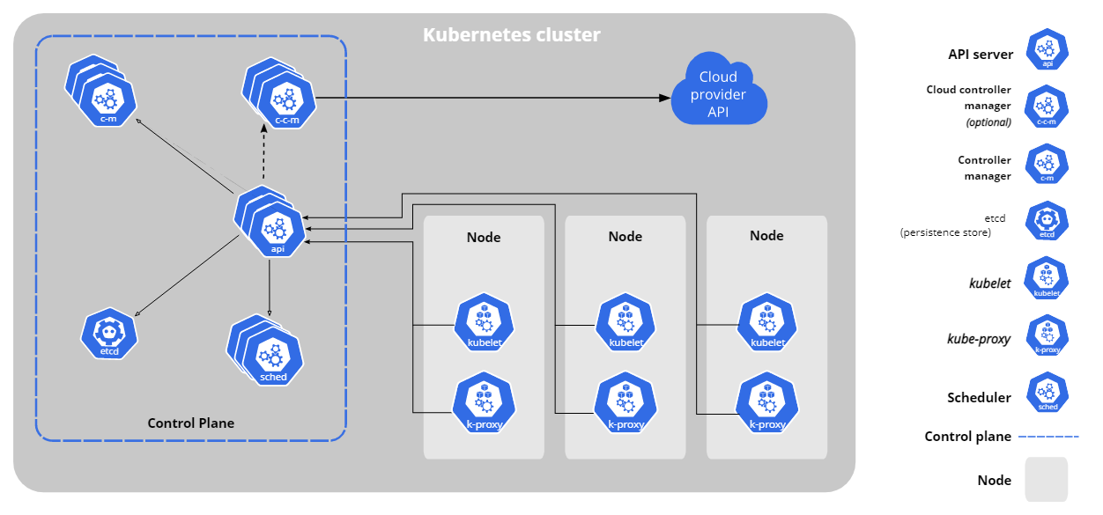

Slide 28
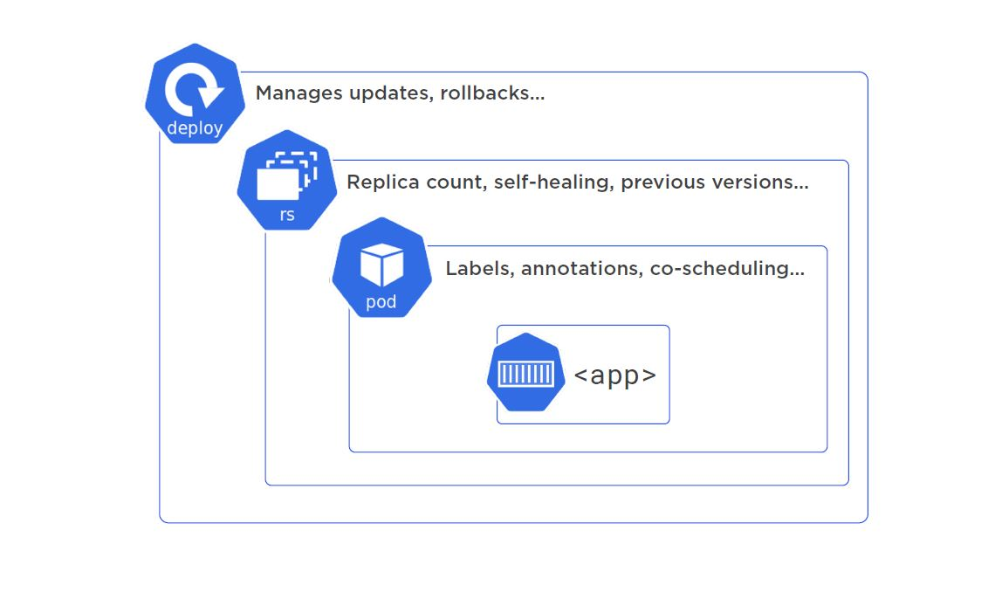

Slide 29
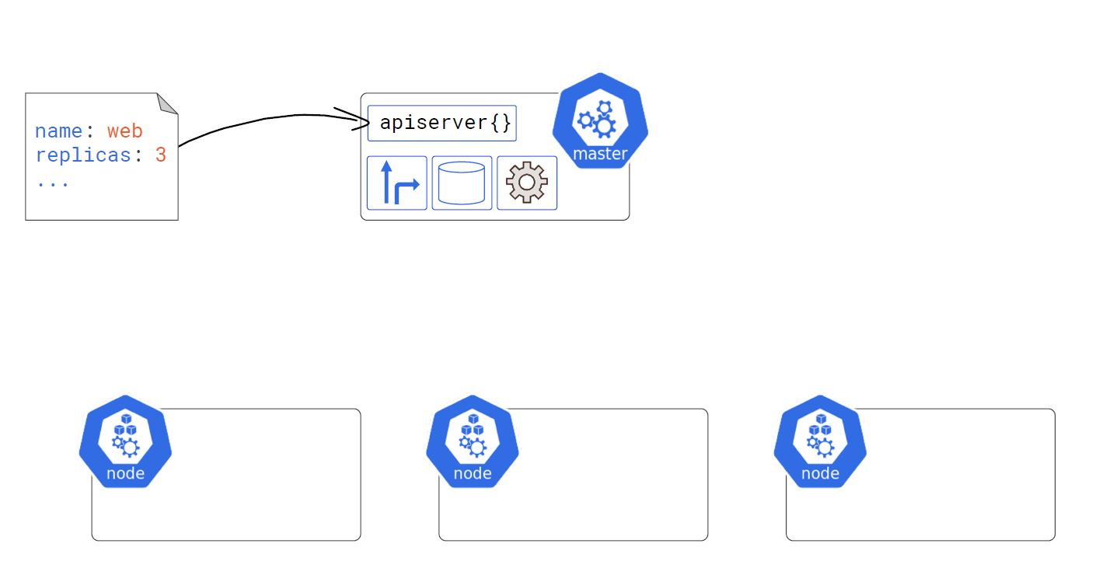
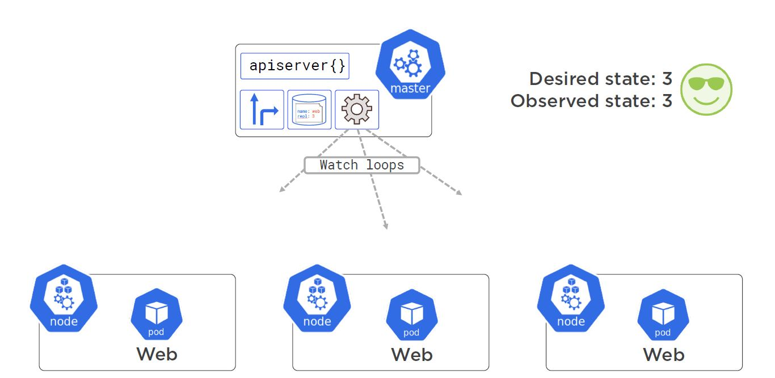

Slide 30
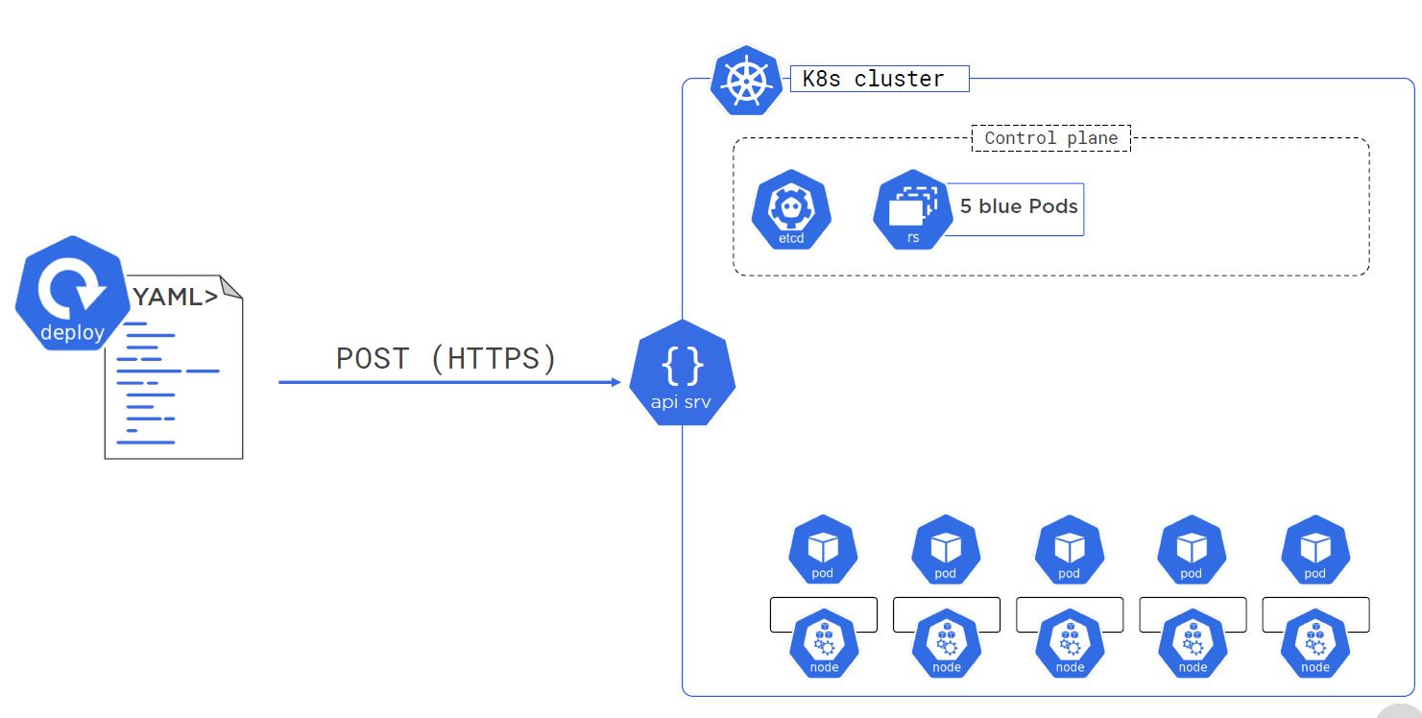
Application deploy and roll back

Slide 31
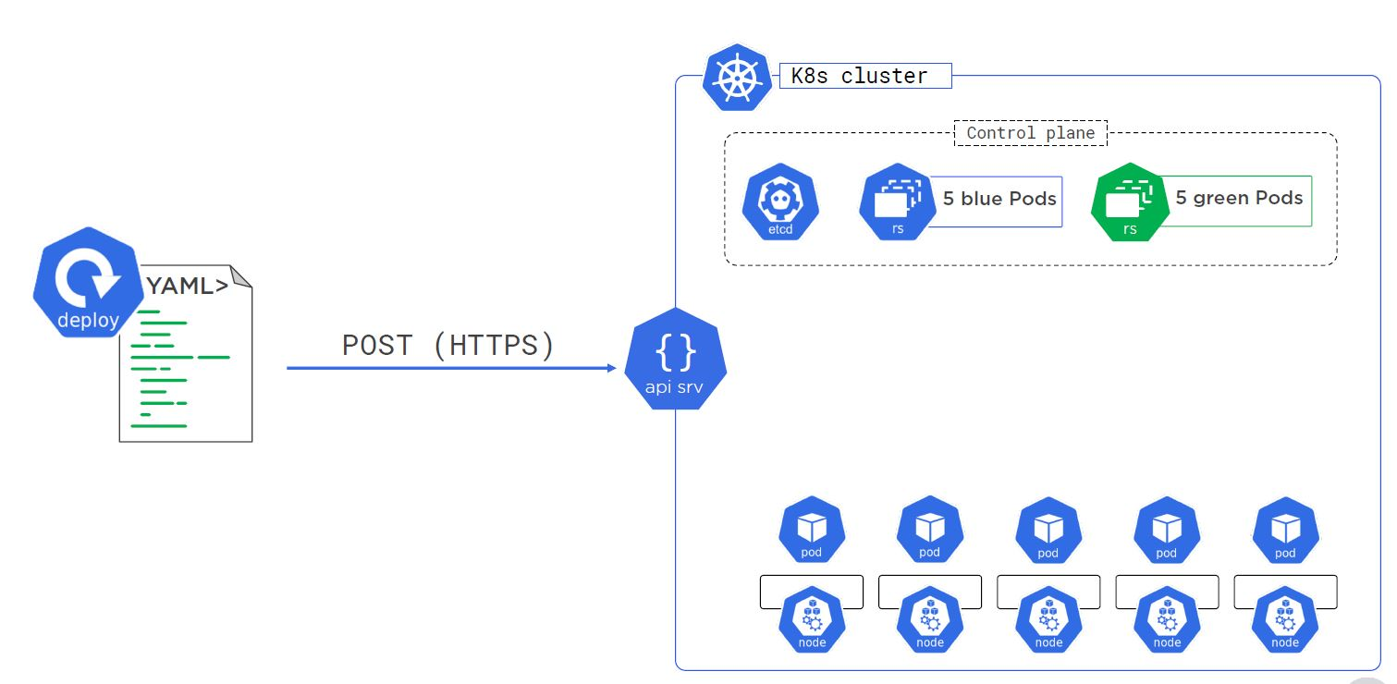

Slide 32
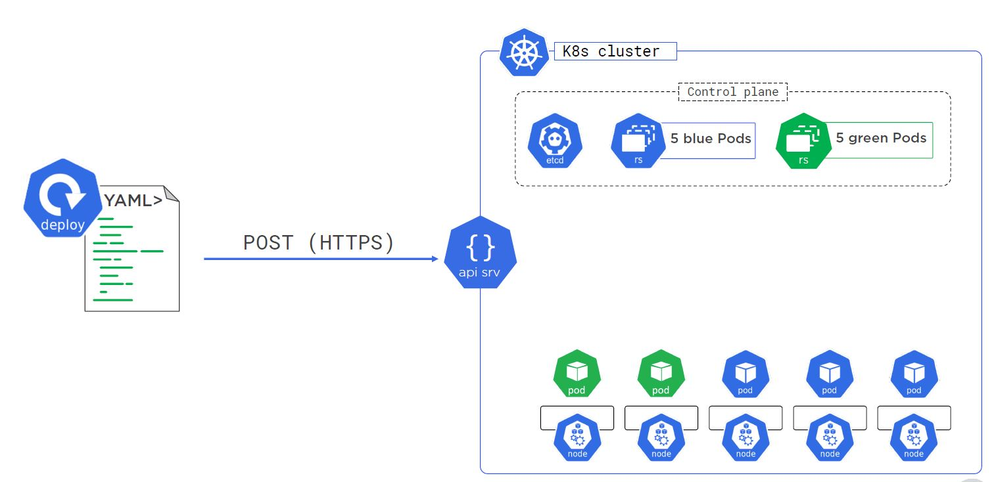

Slide 33
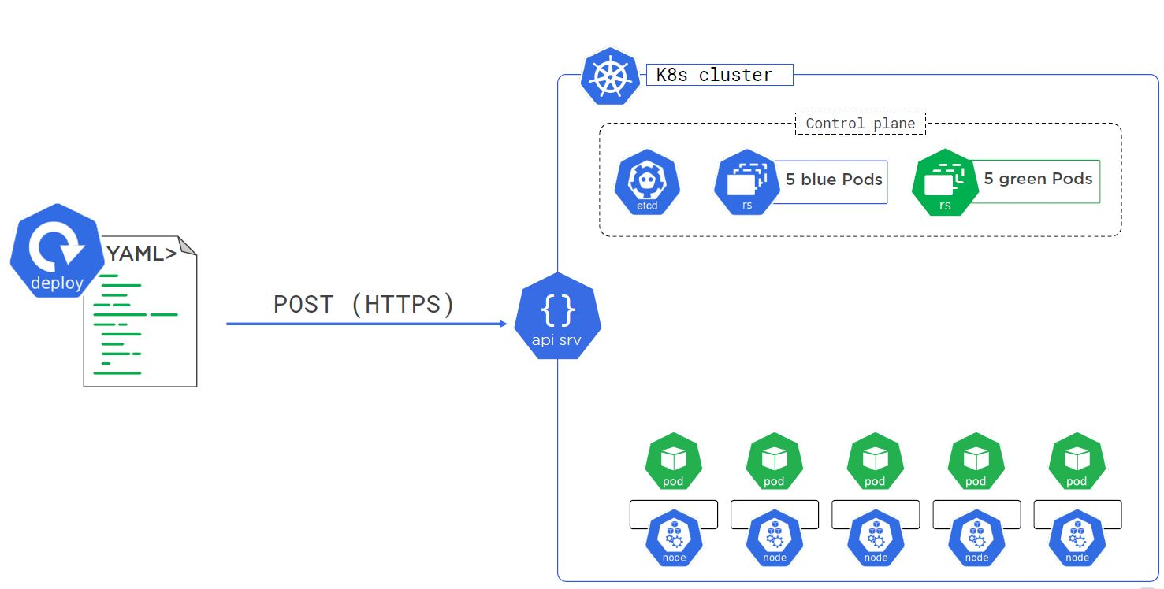

Slide 34
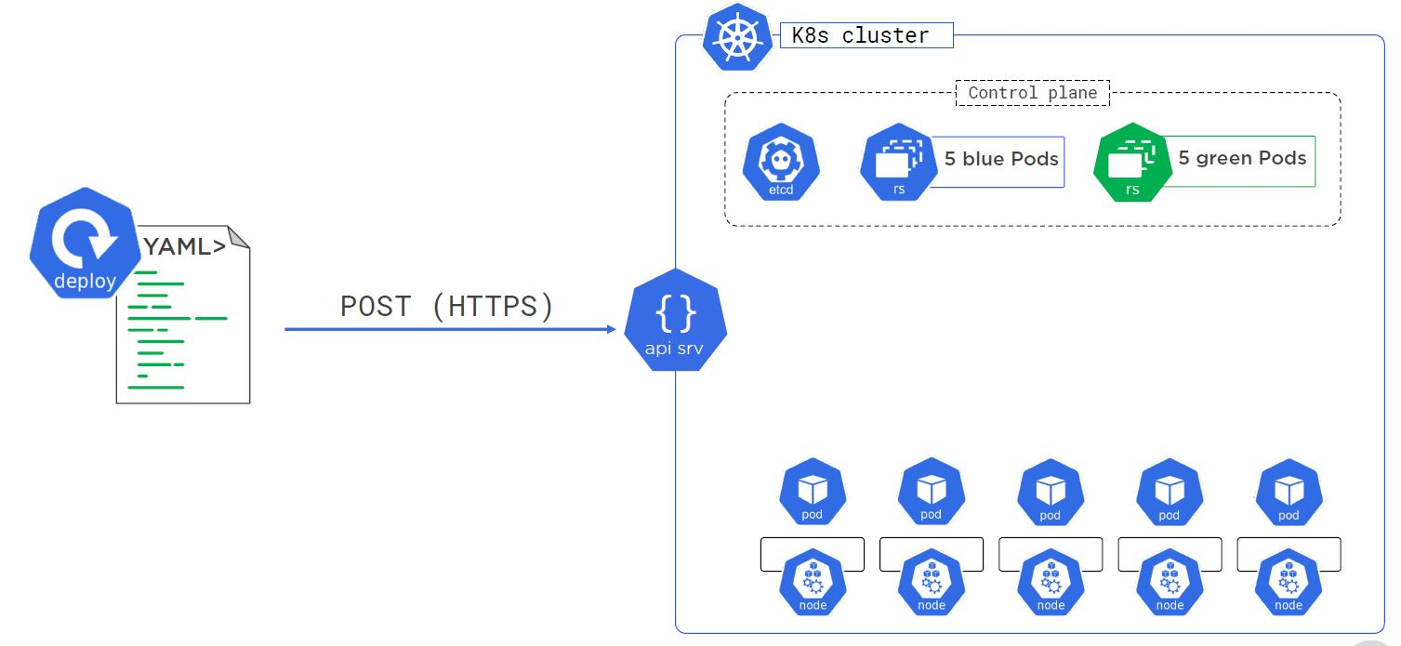

Slide 35
Helm charts
Helm uses a packaging format called charts
A chart is a collection of files that describe a related set of Kubernetes resources

Slide 36
DEMO

Slide 37
Thank You

